Slide 1


Slide 2
Objectives
Explore the characteristics of the houses using some business intelligence tool.
Build a model that will predict the price of a house based on features provided in the dataset.
Understanding which factors are responsible for higher property value - $650K and above. The questions have been provided later in the document for which you can use tableau.

Slide 3
Understanding the dataset
King county is the most populated county in Washington state and the 13th most populated city in the United States
It includes major metropolitan areas like the city of Seattle.
Dataset consists of 21,420 homes in Kings County, WA that were sold in between May 2014 – May 2015.
It contains 20 variables of which will determine what affects the price of a home.

Slide 4
Understanding the Dataset
Target Variable = Price
Defining certain variables:
Id: Unique identification number for the property.
date: date the house was sold.
price: price of the house.
waterfront: house which has a view to a waterfront.
condition: How good the condition is (overall). 1 indicates worn out property and 5 excellent.
grade: Overall grade given to the housing unit, based on King County grading system. 1 poor ,13 excellent.
Sqft_above: square footage of house apart from basement.
Sqft_living15: Living room area in 2015(implies - some renovations). This might or might not have affected the lotsize area.
Sqft_lot15: lotSize area in 2015(implies - some renovations).

Slide 5
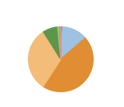
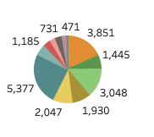
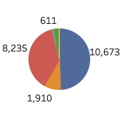
Exploring the data
Min price = $78,000 Average price = 540,739 Max price = $7,700,000
Variable exploration
Bedrooms range 1-33 Bathrooms range 0.5 – 8 Floors range 1- 3.5
Bedroom Count
1
2
1
4
2.5
3
Notes:
Bedrooms 3 – 9,824
4 – 6,882

Slide 6
Exploring the data Variable exploration
Years built range 1900 – 2015
Sq_ftliving range 370sqft – 13,540sq_ft
Basement – Majority of homes do not have a basement
Waterview – Majority of homes do not have a Waterview. Rated 0-1
View – Majority of homes do not have a view. Rated 0-4
Zipcode – More homes sold in 98103
Condition– Most homes condition were of average conditions. Rated 1-5
Grade – Most homes Grade were of average grade. Rated 1-13

Slide 7
Exploring the Data
Average price for a 3 bedroom home = $466,527.48
Average price for a 4 bedroom home = $635,794.49
Average sqft_living for a 3 bedroom home = 1,807 sqft
Average sqft_living for 4 bedroom home = 2,556 sqft
Average price for a waterfront home = $1,662,524.18 vs $532,137.39

Slide 8
Cleaning the data
Checking for nulls – None identified
Checking data types – Integers/Floats
Checking for duplicates – None identified
Drop columns – Id and Date were dropped as they are not relevant to the model
Change column type to object type – Condition, Waterfront, View, Zipcode
Deleted row with 33 bedrooms
Used log and square root transformation to manage outliers

Slide 9
Correlations
Sqft_living, sqft._above and bathrooms were highly correlated to price.
VIF shows sqft_living, sqft_above and sqft_basement are highly correlated to each other. I dropped sqft._above and sqft_basement.
I will also drop yr_renovated as it really does not have any corralation with the price and there is already a variable called sqft_living15 which has a higher corralation to the target.
VIF – 27.6
There is still high correlation between the variables. This can affect the model adversely

Slide 10
Regression Models
Linear regression: 0.8239029220913179
R2 - 0.8229647177490109
Mse = 22363307675.97388
Mae = 89530.0387688366
Decision tree: 0.6593127096904975
R2 = 0.6593127096904975
RMSE = 207451.25745223914
MAE = 119033.75860472296

Slide 11
Regression Models
KNN - 0.7751567788406417
The best model for this data set seems to linear regression.

Slide 12
Visual Data analysis
https://public.tableau.com/views/Midproject_final/Conditionofhomebasedonyearbuilt?:language=en-US&:display_count=n&:origin=viz_share_link

Slide 13
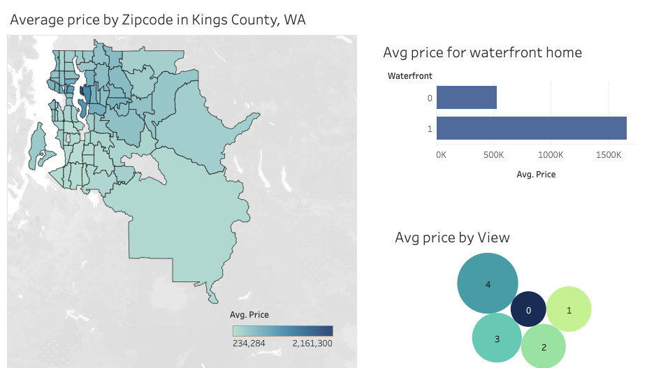
$1,662,524
1,464,363

Slide 14
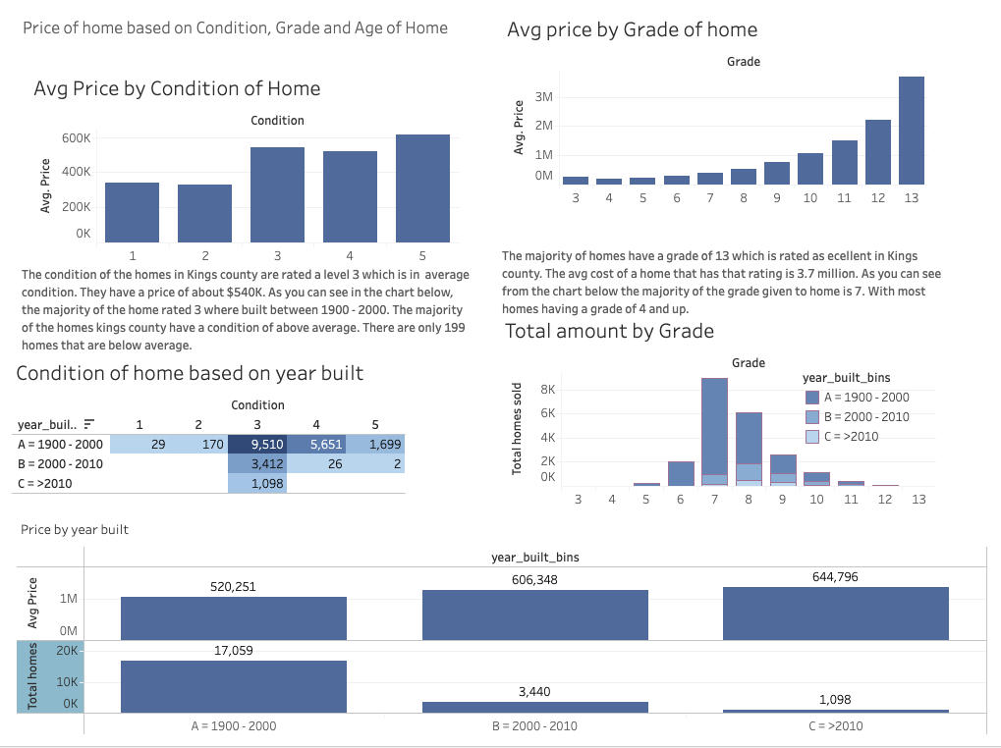

Slide 15
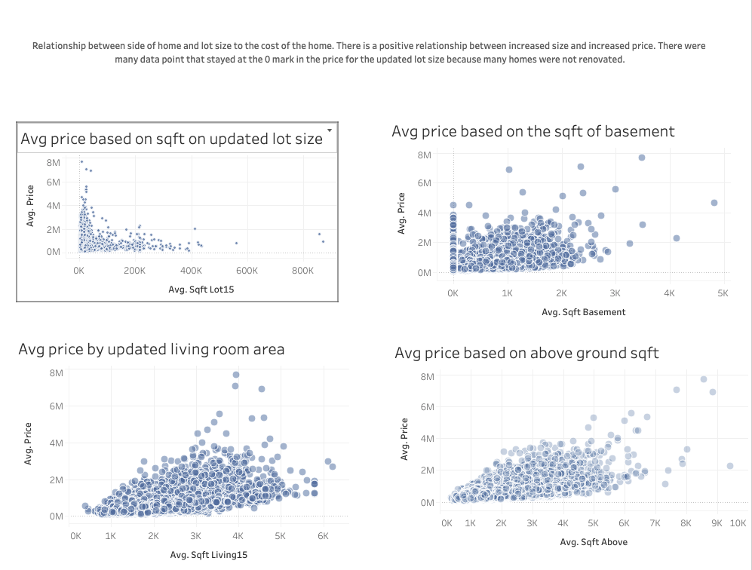

Slide 16
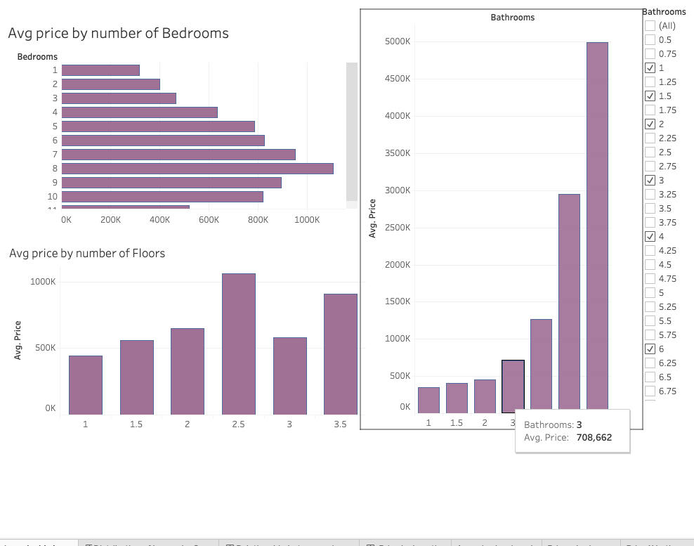

Slide 17
Conclusion
Future projections
I would like to see how the current housing market compares to the housing market from 2015.
I also would like to see the impact on homes conditions during covid due to the rent being held.

